Slide 1
Chapter 5: CPU Scheduling

Slide 2
CPU Scheduling CPU调度
5.1 Basic Concepts
5.2 Scheduling Criteria
5.3 Scheduling Algorithms
5.4 Multiple-Processor Scheduling
5.5 Real-Time Scheduling
5.6 Thread Scheduling
5.7 Operating Systems Examples
5.8 Java Thread Scheduling
5.9 Algorithm Evaluation

Slide 3
OBJECTIVES
Describe various CPU scheduling algorithms.
Assess CPU scheduling algorithms based on scheduling criteria.
Explain the issues related to multiprocessor and multicore scheduling.
Describe various real-time scheduling algorithms.
Describe the scheduling algorithms used in the Windows, Linux, and Solaris operating systems.
Apply modeling and simulations to evaluate CPU scheduling algorithms.
Design a program that implements several different CPU scheduling algorithms.

Slide 4
5.1 Basic Concepts

Slide 5

5.1 Basic Concepts
CPU调度==处理器调度==进程调度
Maximum CPU utilization obtained with multiprogramming
CPU、I/O Burst Cycle脉冲（运行）周期– Process execution consists of a cycle of CPU execution and I/O wait.
CPU Burst Time 、I/O Burst Time
CPU-bound 、I/O-bound program （CPU型、I/O型程序）
CPU burst distribution

Slide 6
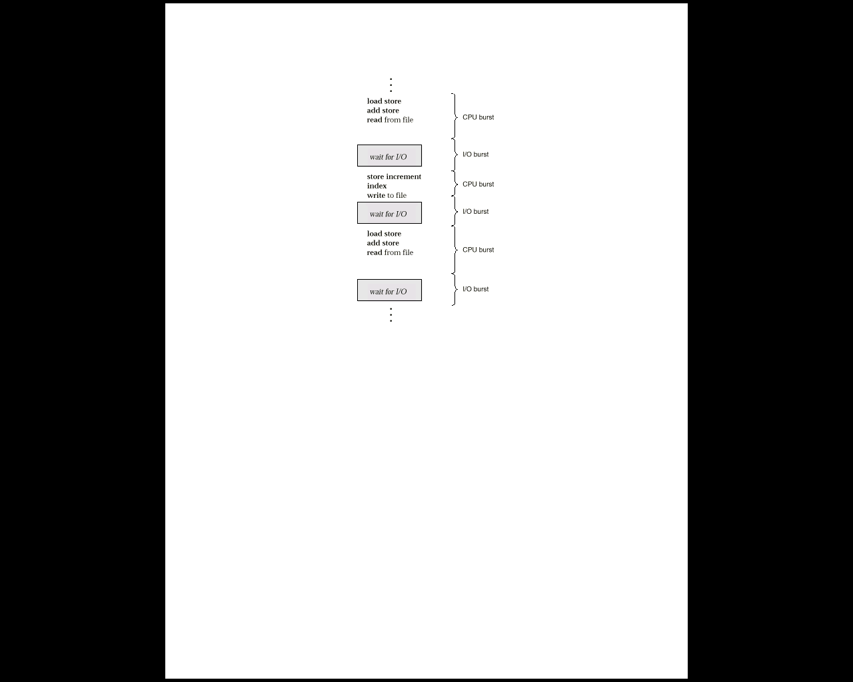
Fig 5.1 Alternating Sequence of CPU And I/O Bursts

Slide 7
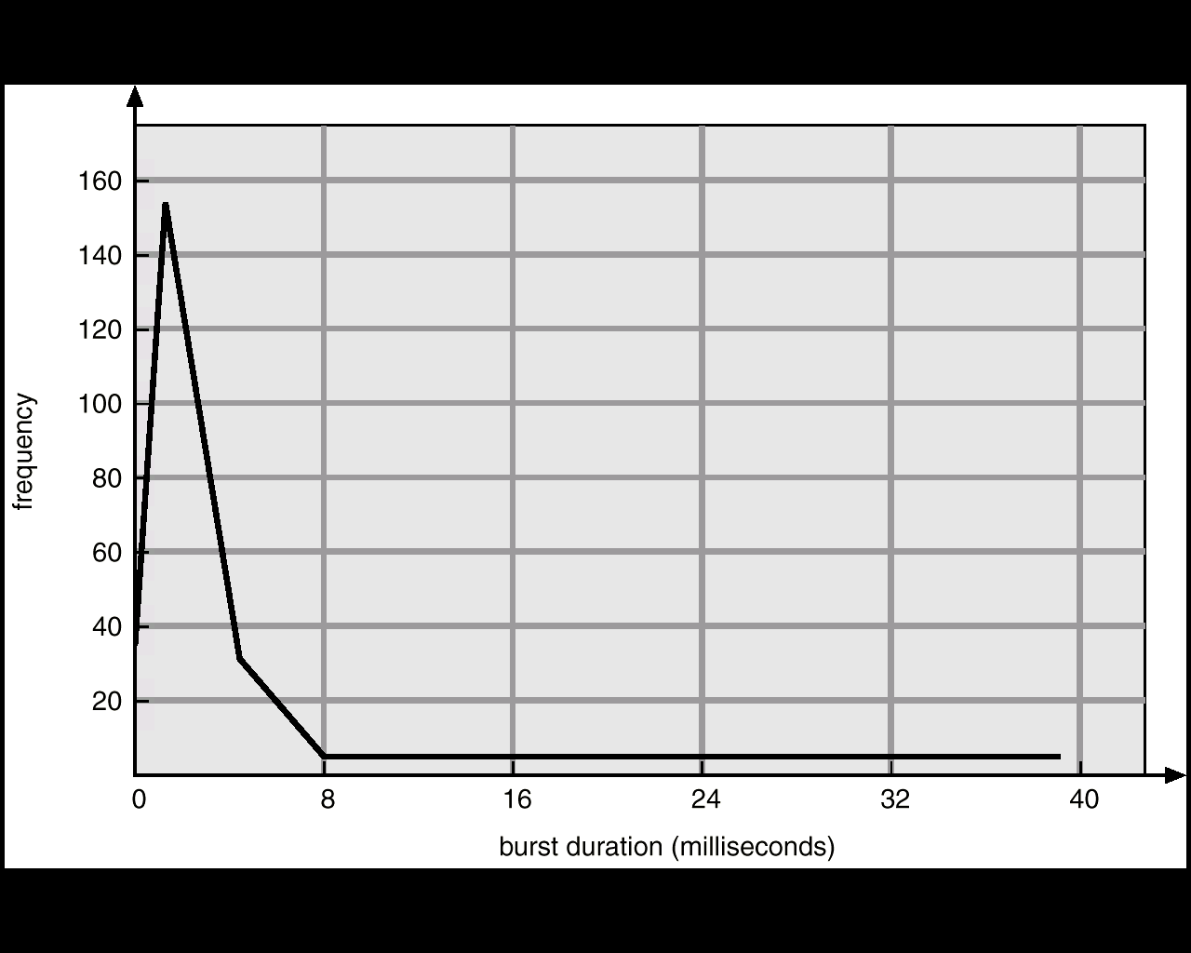
Histogram of CPU-burst Times

Slide 8
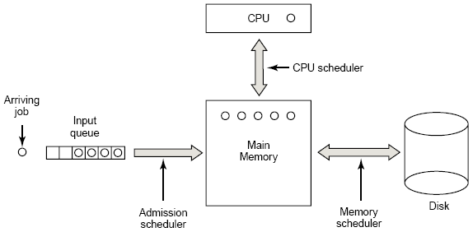
Three-level Scheduling
SHORT-TERM
LONG-TERM
MID-TERM

Slide 9
CPU Scheduler
CPU scheduling decisions may take place when a process（调度的时机）:
1. Switches from running to waiting state.
2.Switches from running to ready state.
3.Switches from waiting to ready.
4.Terminates.
调度方式：
非抢占式（Nonpreemptive）调度:调度程序一旦把处理器分配给某进程后便让它一直运行下去，直到进程完成或发生某事件而阻塞时，才把处理器分配给另一个进程。如上1、4
抢占式（Preemptive）调度:当一个进程正在运行时，系统可以基于某种原则，剥夺已分配给它的处理机，将之分配给其它进程。剥夺原则有：优先权原则、短进程优先原则、时间片原则。如上2、3
process
process
process
process

Slide 10
Dispatcher（调度程序）
Dispatcher module gives control of the CPU to the process selected by the short-term scheduler; this involves:
switching context
switching to user mode
jumping to the proper location in the user program to restart that program
Dispatch latency（调度延迟） – time it takes for the dispatcher to stop one process and start another running调度程序停止一个进程到启动一个进程所需要的时间
Linux命令：vmstat

Slide 11
5.2 Scheduling Criteria

Slide 12

调度算法的选择准则和评价
1.面向用户(User-oriented)的准则和评价
周转时间Turnaround time ：进程从提交到完成所经历的时间。包括：在CPU上执行，就绪队列和阻塞队列中等待。
周转时间 T=完成时间-提交时间
平均周转时间=∑周转时间/进程数
带权周转时间W= T(周转时间)/t(CPU执行时间)
平均带权周转时间=∑W/进程数
响应时间Response time ：从进程提出请求到首次被响应（而不是输出结果）的时间段（在分时系统环境下）
等待时间Waiting time – 进程在就绪队列中等待的时间总和
截止时间：开始截止时间和完成截止时间－－实时系统，与周转时间有些相似。
公平性：不因作业或进程本身的特性而使上述指标过分恶化。如长进程等待很长时间。
优先级：可以使关键任务达到更好的指标

Slide 13
调度算法的选择准则和评价
2. 面向系统的调度性能准则
吞吐量Throughput ：单位时间内所完成的进程数，跟进程本身特性和调度算法都有关系－－批处理系统
平均周转时间不是吞吐量的倒数，因为并发执行的进程在时间上可以重叠。如：在2小时内完成4个进程，而每个周转时间是1小时，则吞吐量是2个进程/小时
处理器利用率CPU utilization：使CPU尽可能的忙碌
各种设备的均衡利用：如CPU繁忙的进程和I/O繁忙的进程搭配－－大中型主机
3. 调度算法本身的调度性能准则
易于实现
执行开销比较小

Slide 14
4. Optimization Criteria最优准则
最大的CPU利用率 Max CPU utilization
最大的吞吐量 Max throughput
最短的周转时间 Min turnaround time
最短的等待时间 Min waiting time
最短的响应时间 Min response time
公平

Slide 15
5.3 Scheduling Algorithms

Slide 16
Scheduling Algorithms
First-Come, First-Served (FCFS) Scheduling先来先服务调度
Shortest-Job-First (SJF) Scheduling 短作业优先调度
Priority Scheduling 优先权调度
Round Robin (RR) 时间片轮转调度
Multilevel Queue Scheduling 多级队列调度
Multilevel Feedback Queue Scheduling多级反馈队列调度
高响应比优先调度算法 Highest Response Ratio Next(HRRN)
响应比R = (等待时间 + 要求执行时间) / 要求执行时间
Notes:
高响应比优先调度算法既考虑作业的执行时间也考虑作业的等待时间，综合了先来先服务和最短作业优先两种算法的特点。
高响应比优先调度算法的基本思想是把CPU分配给就绪队列中响应比最高的进程。

Slide 17
5.3.1 First-Come, First-Served (FCFS) Scheduling
FCFS算法
按照进程或作业提交顺序形成就绪状态的先后次序，分派CPU
当前进程或作业占用CPU，直到执行完或阻塞，才出让CPU（非抢占方式）
在进程或作业唤醒后（如I/O完成），并不立即恢复执行，通常等到当前作业或进程出让CPU
最简单的算法
FCFS的特点
比较有利于长进程，而不利于短进程。
有利于CPU Bound的进程，而不利于I/O Bound的进程。

Slide 18
FCFS Scheduling(Cont.)
Process Burst Time
P₁ 24
P₂ 3
P₃ 3
Suppose that the processes arrive in the order: P₁ , P₂ , P₃
The Gantt Chart for the schedule is:
Waiting time for P1 = 0; P2 = 24; P3 = 27
Turnaround time for P1 = 24; P2 = 27; P3 = 30
Average waiting time: (0 + 24 + 27)/3 = 17
Average Turnaround time: (24 + 27 + 30)/3 = 27
P₁
P₂
P₃
0
24
27
30
turnaround time = termination time – arrival time.

Slide 19
FCFS Scheduling (Cont.)
Suppose that the processes arrive in the order P₂ , P₃ , P₁ .
The Gantt chart for the schedule is:
Waiting time : for P1 = 6; P2 = 0; P3 = 3
Turnaround time：for P1 = 30; P2 = 3; P3 = 6
Average waiting time : (6 + 0 + 3)/3 = 3
Average Turnaround time: (30 + 3 + 6)/3 = 13
Much better than previous case.
Convoy effect short process behind long process
Process | CPU
P₁ | 24
P₂ | 3
P₃ | 3
P₂
P₃
P₁
0
3
6
30
What if the arrival
order is changed?
Waiting time = turnaround time – burst time.

Slide 20
5.3.2 Shortest-Job-First (SJF) Scheduling
又称为“短进程优先”SPF(Shortest Process First)；这是对FCFS算法的改进，其目标是减少平均周转时间。
SJF算法:
对预计执行时间短的作业（进程）优先分派处理器。
Two schemes:
nonpreemptive – once CPU given to the process it cannot be preempted until completes its CPU burst
preemptive – if a new process arrives with CPU burst length less than remaining time of current executing process, preempt. This scheme is know as the Shortest-Remaining-Time-First (SRTF)
SJF is optimal – gives minimum average waiting time for a given set of processes.

Slide 21

SJF的变型
最短剩余时间优先SRTF(Shortest Remaining Time First)-基于抢占的SJF算法
允许比当前进程剩余时间更短的进程来抢占
最高响应比优先HRRN(Highest Response Ratio Next)
响应比R = (等待时间 + 要求执行时间) / 要求执行时间
是FCFS和SJF的折衷

Slide 22
Example of Non-Preemptive SJF
Process Arrival Time Burst Time
P₁ 0 7
P₂ 2 4
P₃ 4 1
P₄ 5 4
SJF (non-preemptive)
Average Turnaround time=(7+10+4+11)/4=8
Average waiting time = (0 + 6 + 3 + 7)/4 = 4
P₁
P₃
P₂
P₄
0
3
7
8
12
16
turnaround time = termination time – arrival time.

Slide 23
Example of Preemptive SJF
Process Arrival Time Burst Time
P₁ 0 7
P₂ 2 4
P₃ 4 1
P₄ 5 4
SJF (preemptive)
Average Turnaround time=(16+5+1+6)/4=7
Average waiting time = (9 + 1 + 0 +2)/4 = 3
P₁
P₂
P₃
P₂
P₄
P₁
0
2
4
5
7
11
16

Slide 24
Determining Length of Next CPU Burst
Can only estimate the length.
Can be done by using the length of previous CPU bursts, using exponential averaging.
Notes:
难点：如何知道下一CPU burst的长度。
1) 对于（batch system中的）long-term job scheduling，可将用户提交job时所指定的process time limit作为长度。
2) 对于short-term CPU scheduling，下一CPU burst的长度无法知道。可对下一CPU burst长度进行预测，选择具有最短预测CPU burst的进程。

Slide 25
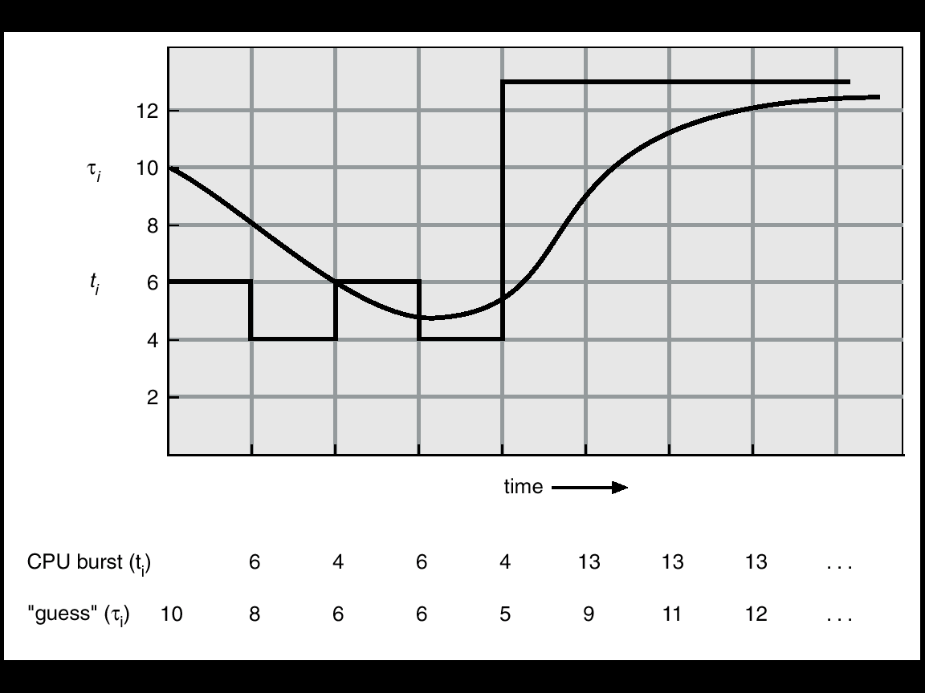
Fig 5.3 Prediction of the Length of the Next CPU Burst

Slide 26
Examples of Exponential Averaging
α =0
τ_{n+1} = τ_{n}
Recent history does not count.
α =1
τ_{n+1} = t_{n}
Only the actual last CPU burst counts.
If we expand the formula, we get:
τ_{n+1} = α t_{n}+(1 - α) α t_{n-1} + …
+(1 - α )^{j} α t_{n-j} + …
+(1 - α )^{n+1} τ₀
Since both α and (1 - α) are less than or equal to 1, each successive term has less weight than its predecessor.

Slide 27
5.3.3 Priority Scheduling
Associate a priority number with each process
该算法总是把处理机分配给就绪队列中具有最高优先权的进程。常用以下两种方法来确定进程的优先权：
静态优先权: 静态优先权是在创建进程时确定的，在整个运行期间不再改变。依据有：进程类型、进程对资源的要求、用户要求的优先权。
动态优先权: 动态优先权是基于某种原则，使进程的优先权随时间改变而改变。
假定：最小的整数 ≡ 最高的优先级.
SJF是以下一次CPU脉冲长度作为优先数的优先级调度
typically, a lower priority number indicates a higher priority

Slide 28
Priority Scheduling
Is priority scheduling preemptive or non-reemptive?
Non-preemptive priority scheduling places higher-priority processes at the head of the queue
Preemptive priority scheduling requires a running process to be interrupted and preempted upon the arrival of a higher-priority process

Slide 29
Example of Priority Scheduling
Process Burst Time Priority
P₁ 10 3
P₂ 1 1
P₃ 2 4
P₄ 1 5
P₅ 5 2
non-preemptive
Average Turnaround time=(16+1+18+19+6)/5=12
Average waiting time = (6+0+16 +18 +1)/5 = 8.2
P₂
P₅
P₁
P₃
P₄
0
1
6
16
18
19

Slide 30
Example of Priority Scheduling
Process Arrival Time Burst Time Priority
P₁ 0 10 3
P₂ 1 1 1
P₃ 4 2 4
P₄ 5 1 2
P₅ 8 5 2
preemptive
Average Turnaround time=(17+1+15+1+5)/5=7.8
Average waiting time = (7+0+13 +0 +0)/5 = 4
P₁
P₂
P₁
P₄
P₁
P₅
P₁
P₃
0
1
2
5
6
8
13
17
19

Slide 31

Priority Scheduling (Cont.)
Problem ：Starvation(饥饿)– low priority processes may never execute.
( Rumor has it that ,When they shut down the IBM 7094 at MIT in 1973,they found a low-priority process that had been submitted in 1967 and had not yet been run)
Solution ： Aging(老化)– as time progresses increase the priority of the process.——动态优先级

Slide 32
5.3.4时间片轮转调度Round Robin (RR)
基本思路：通过时间片轮转，提高进程并发性和响应时间特性，从而提高资源利用率。
RR算法：
将系统中所有的就绪进程按照FCFS原则，排成一个队列。
每次调度时将CPU分派给队首进程，让其执行一个时间片 (time slice) 。时间片的长度从几个ms到几百ms。
在一个时间片结束时，发生时钟中断。
调度程序据此暂停当前进程的执行，将其送到就绪队列的末尾，并通过上下文切换执行当前的队首进程。
进程可以未使用完一个时间片，就出让CPU（如阻塞）。

Slide 33
5.3.4 Round Robin (RR)
Each process gets a small unit of CPU time (time quantum), usually 10-100 milliseconds. After this time has elapsed, the process is preempted and added to the end of the ready queue.
我饿饿
我饿饿
我不想吃饭饭
我不想吃饭饭
我不想吃饭饭
RR情境

Slide 34
Round Robin
If there are n processes in the ready queue and the time quantum is q, then each process gets 1/n of the CPU time in chunks of at most q time units at once. No process waits more than (n-1)q time units.
Performance
q large ⇒ FIFO
q small ⇒ q must be large with respect to context switch, otherwise overhead is too high
时间片长度的影响因素：
就绪进程的数目：数目越多，时间片越小（当响应时间一定时）
系统的处理能力：应当使用户输入通常在一个时间片内能处理完，否则使响应时间，平均周转时间和平均带权周转时间延长。
Why？

Slide 35
Example of RR with Time Quantum = 20
Process Burst Time
P₁ 53
P₂ 17
P₃ 68
P₄ 24
The Gantt chart is:
Typically, higher average turnaround than SJF, but better response.
P₁
P₂
P₃
P₄
P₁
P₃
P₄
P₁
P₃
P₃
0
20
37
57
77
97
117
121
134
154
162
Average Turnaround time=(134+37+162+121)/4=113.5
Average waiting time = (81+20+94 +97 )/4= 70.5

Slide 36
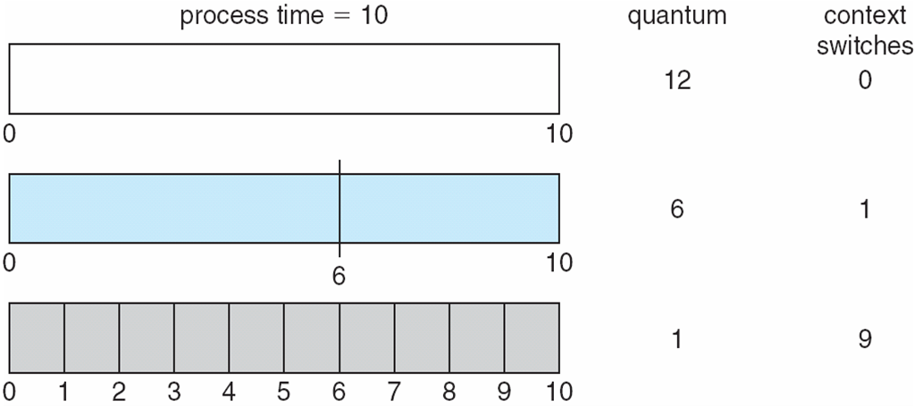
Fig 5.4 Time Quantum and Context Switch Time

Slide 37
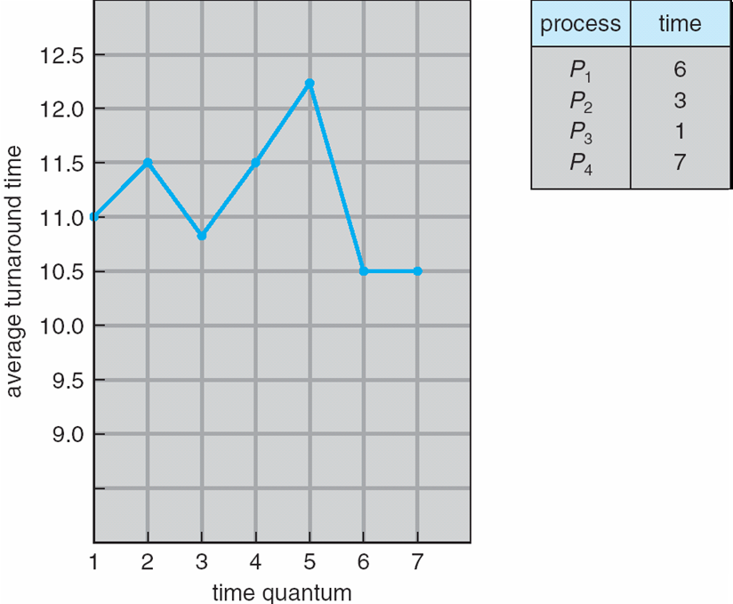
Turnaround Time Varies With The Time Quantum
80% of CPU bursts should be shorter than q

Slide 38
5.3.5 多级队列调度
根据进程的性质或类型的不同，将就绪队列再分为若干个子队列。
每个作业固定归入一个队列。
各队列的不同处理：不同队列可有不同的优先级、时间片长度、调度策略等。如：系统进程、用户交互进程、批处理进程等。
本算法引入多个就绪队列，通过各队列的区别对待，达到一个综合的调度目标

Slide 39
Multilevel Queue Scheduling
Ready queue is partitioned into separate queues:
foreground (interactive) 前台（交互式）
background (batch) 后台 （批处理）
Each queue has its own scheduling algorithm:
foreground – RR
background – FCFS

Slide 40
Multilevel Queue Scheduling (Cont.)
多级队列算法调度须在队列间进行
固定优先级调度，即前台运行完后再运行后台。有可能产生饥饿
给定时间片调度，即每个队列得到一定的CPU时间，进程在给定时间内执行；如，80%的时间执行前台的RR调度，20%的时间执行后台的FCFS调度

Slide 41
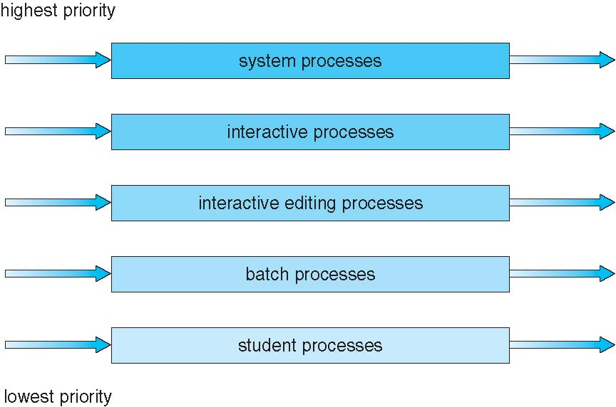
Multilevel Queue Scheduling (Cont.)

Slide 42
5.3.6 Multilevel Feedback Queue Scheduling
多级反馈队列算法是时间片轮转算法和优先级算法的综合和发展。优点：
为提高系统吞吐量和缩短平均周转时间而照顾短进程
为获得较好的I/O设备利用率和缩短响应时间而照顾I/O型进程
不必估计进程的执行时间，动态调节

Slide 43
多级反馈队列算法
设置多个就绪队列，分别赋予不同的优先级，如逐级降低，队列1的优先级最高。每个队列执行时间片的长度也不同，规定优先级越低则时间片越长，如逐级加倍
新进程进入内存后，先投入队列1的末尾，按FCFS算法调度；若按队列1一个时间片未能执行完，则降低投入到队列2的末尾，同样按FCFS算法调度；如此下去，降低到最后的队列，则按"时间片轮转"算法调度直到完成。
仅当较高优先级的队列为空，才调度较低优先级的队列中的进程执行。如果进程执行时有新进程进入较高优先级的队列，则抢占执行新进程，并把被抢占的进程投入原队列的末尾。

Slide 44
几点说明
I/O型进程：让其进入最高优先级队列，以及时响应I/O交互。通常执行一个小时间片，要求可处理完一次I/O请求的数据，然后转入到阻塞队列。
计算型进程：每次执行完时间片，进入更低优先级级队列。最终采用最大时间片来执行，减少调度次数。
I/O次数不多，而主要是CPU处理的进程：在I/O完成后，优先放回I/O请求时离开的队列，以免每次都回到最高优先级队列后再逐次下降。
为适应一个进程在不同时间段的运行特点，I/O完成时，提高优先级；时间片用完时，降低优先级；

Slide 45
Example of Multilevel Feedback Queue
Example of Multilevel Feedback Queue Three queues:
Q₀ – time quantum 8 milliseconds
Q₁ – time quantum 16 milliseconds
Q₂ – FCFS

Slide 46
Example of Multilevel Feedback Queue
Scheduling
A new job enters queue Q₀ at the end. When it gains CPU, job receives 8 milliseconds. If it does not finish in 8 milliseconds, job is moved to queue Q₁.
At Q₁ job is at the end and receives 16 additional milliseconds. If it still does not complete, it is preempted and moved to queue Q₂.

Slide 47
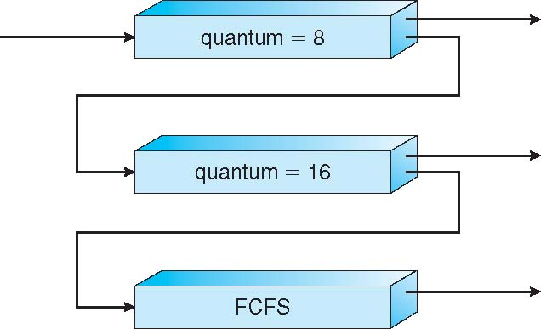
Fig 5.7 Multilevel Feedback Queues

Slide 48
进程调度例题分析
假定在一个处理机上执行以下五个进程：
进程号 到达时间 运行时间 优先数
P1 0 35 2
P2 10 30 3
P3 15 45 4
P4 20 20 1
P5 30 30 4
分别采用FCFS、SJF和非抢占优先数三种调度算法时：
①画出调度Gantt图；
②计算每个进程的周转时间 ；
③计算平均周转时间。

Slide 49
进程调度例题分析
FCFS：
P1
P2
P3
P4
P5
35 65 110 130 160
SJF（非抢占）：
P1
P4
P2
P5
P3
35 55 85 115 160
优先数（非抢占）：
P1
P4
P2
P3
P5
35 55 85 130 160
算法 | 每个进程周转时间 |  |  |  |  | 平均周转时间
 | P1 | P2 | P3 | P4 | P5
FCFS | 35 | 55 | 95 | 110 | 130 | 85
SJF | 35 | 75 | 145 | 35 | 85 | 75
优先数 | 35 | 75 | 115 | 35 | 130 | 78

Slide 50
5.4* Multiple-Processor Scheduling
CPU scheduling more complex when multiple CPUs are available
Homogeneous processors within a multiprocessor
Load sharing
Asymmetric multiprocessing – only one processor accesses the system data structures, alleviating the need for data sharing

Slide 51
5.5* Thread Scheduling

Slide 52
Thread Scheduling
Local Scheduling – How the threads library decides which thread to put onto an available LWP
Global Scheduling – How the kernel decides which kernel thread to run next

Slide 53
Pthread Scheduling API
#include <pthread.h>
#include <stdio.h>
#define NUM_THREADS 5
int main(int argc, char *argv[])
{
int i;
pthread t tid[NUM THREADS];
pthread attr t attr;
/* get the default attributes */
pthread_attr_init(&attr);
/* set the scheduling algorithm to PROCESS or SYSTEM */
pthread_attr_setscope(&attr, PTHREAD_SCOPE_SYSTEM);
/* set the scheduling policy - FIFO, RT, or OTHER */
pthread_attr_setschedpolicy(&attr, SCHED_OTHER);
/* create the threads */
for (i = 0; i < NUM_THREADS; i++)
pthread_create(&tid[i],&attr,runner,NULL);

Slide 54
Pthread Scheduling API
/* now join on each thread */
for (i = 0; i < NUM THREADS; i++)
pthread_join(tid[i], NULL);
}
/* Each thread will begin control in this function */
void *runner(void *param)
{
printf("I am a thread\n");
pthread exit(0);
}

Slide 55
5.6 Operating System Examples
Solaris scheduling
Windows XP scheduling
Linux scheduling

Slide 56
Linux Scheduling
Two algorithms: time-sharing and real-time
Time-sharing
Prioritized credit-based – process with most credits is scheduled next
Credit subtracted when timer interrupt occurs
When credit = 0, another process chosen
When all processes have credit = 0, recrediting occurs
Based on factors including priority and history
Real-time
Soft real-time
Posix.1b compliant – two classes
FCFS and RR
Highest priority process always runs first

Slide 57
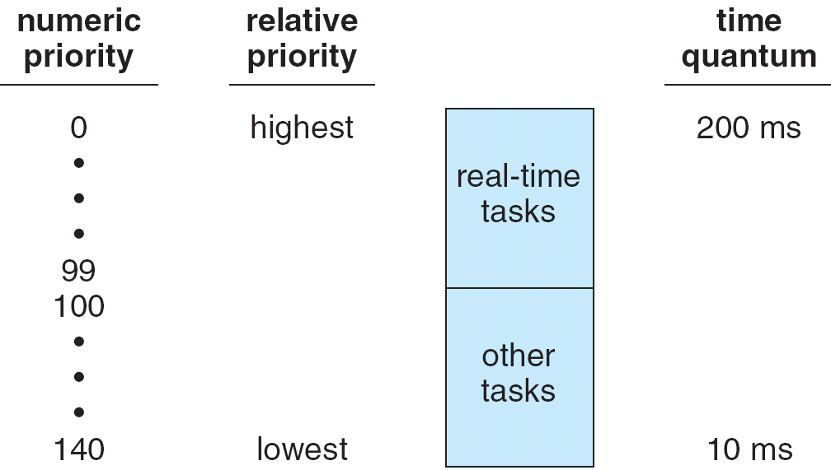
The Relationship Between Priorities and Time-slice length

Slide 58
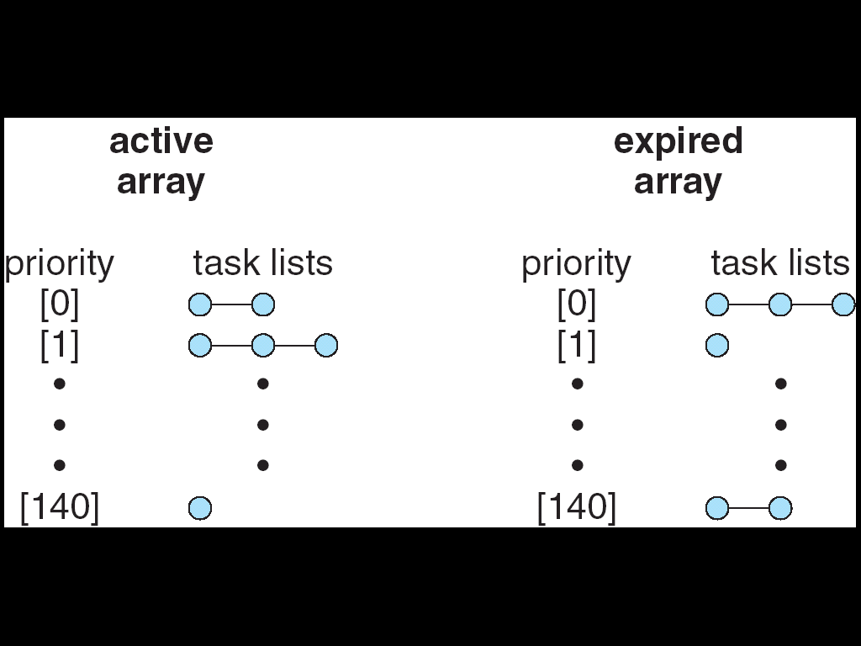
List of Tasks Indexed According to Prorities

Slide 59
Summary
CPU Burst Time 、I/O Burst Time
CPU-bound program（CPU型程序） 、I/O-bound program（I/O型程序）
long-term scheduler（长程调度）、medium-term scheduler（中程调度）short-term scheduler（短程调度）
time slicing（时间片）
response time（响应时间）、turnaround time（周转时间）、waiting time（等待时间）、Average Turnaround time（平均周转时间）Average waiting time（平均等待时间）
preemptive scheduling（抢占式调度）Nonpreemptive scheduling（非抢占式调度）
throughput（吞吐量）

Slide 60
Summary
selecting a process from the ready queue and allocating CPU to it
scheduling algorithms
first-come, first served (FCFS)
shortest job first (SJF)
provably optimal, but difficult to know CPU burst
general priority scheduling
starvation, and aging
round-robin (RR)
for time-sharing, interactive system
problem: how to select the time quantum?
Multilevel queue
different algorithms for different classes of processes
Multilevel feedback queue
allow process to move from one (ready) queue to another

Slide 61
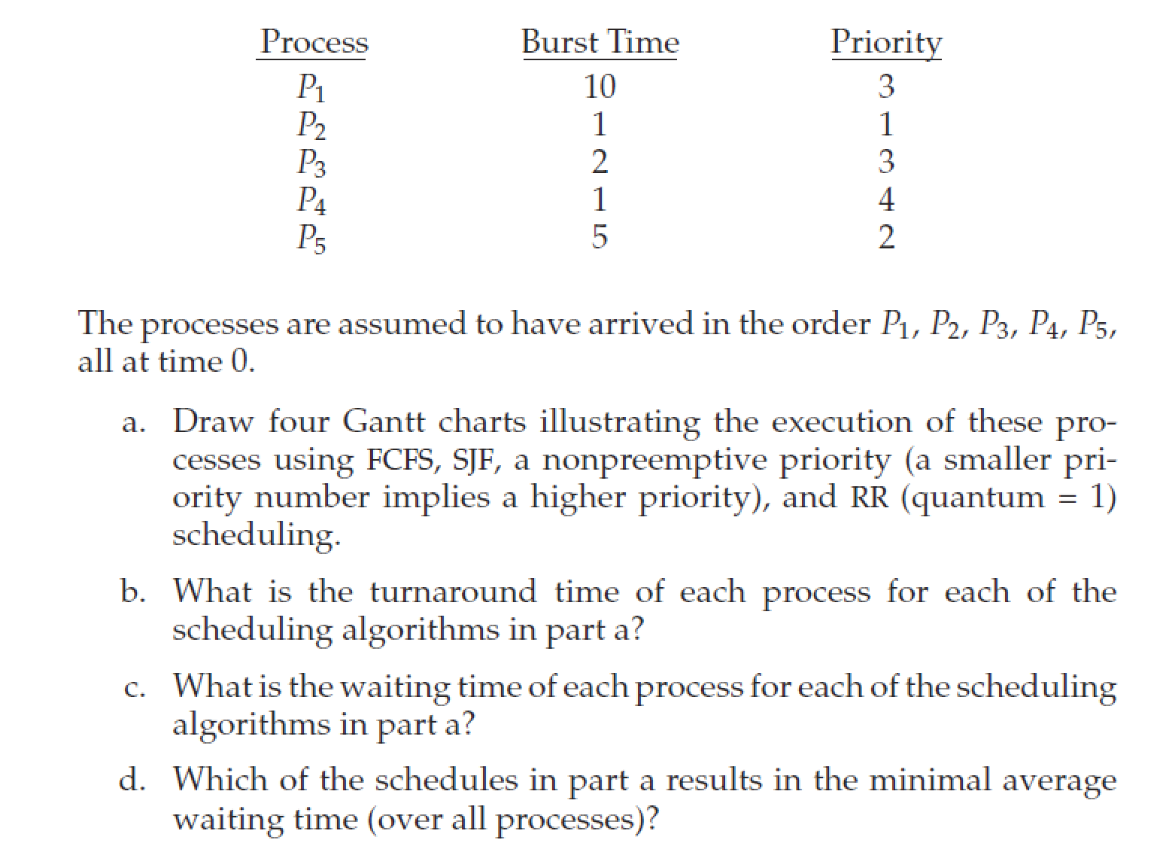
课堂习题

Slide 62
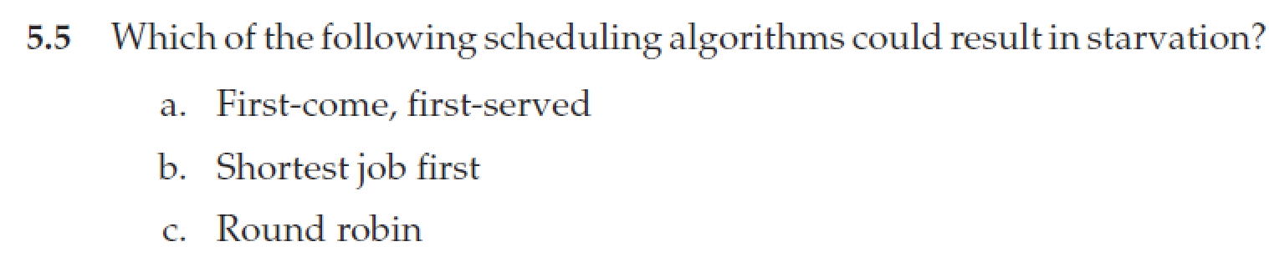
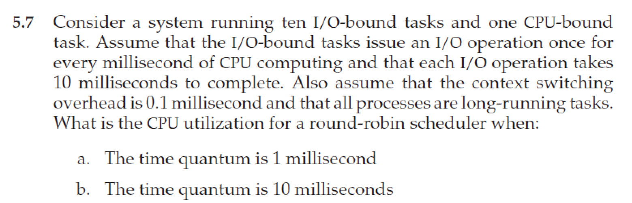
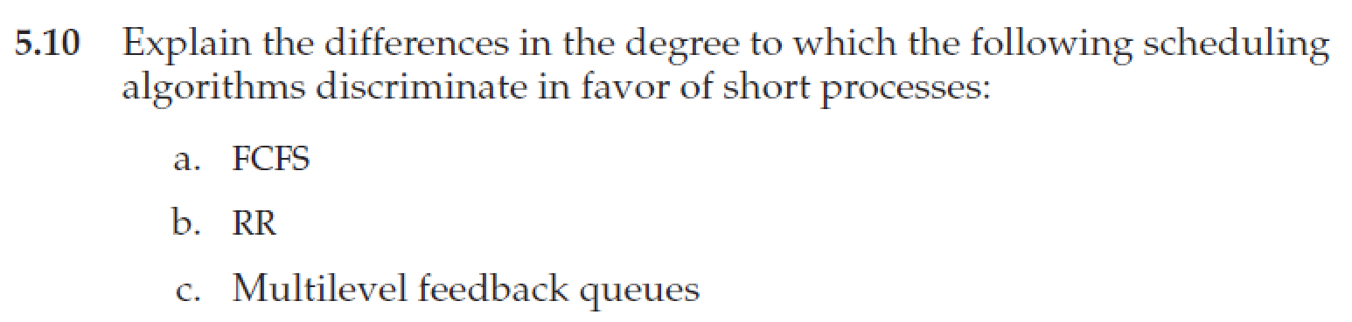
Homework
书后习题5.5、5.7、5.10
10月31日晚上12点前发邮件给TA（刘瑞峰，22021258@zju.edu.cn）
文件名以“学号-姓名-作业x”命名，例如“3170100000-张三-作业3”

Slide 63
End of Chapter

